Slide 1
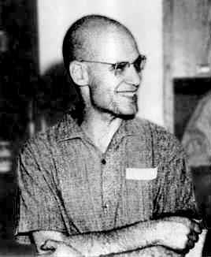
Alexander Grothendieck

Slide 2
Background
Born 28 march 1928, in Germany
Raised in France
Could speak French, English, and German
Son of Alexander Schapiro and Johanna Grothendieck
Studied at
University of Montpellier
University of Nancy
University of São Paulo
University of Kansas

Slide 3
Areas
Institut des Hautes Études Scientifiques
Worked on
Algebraic geometry
Number theory (Study of integers)
Topology (Shapes and Spaces)
Category theory
Complex analysis

Slide 4
Mathematic Work
Grothendieck–Riemann–Roch theorem
K-theory
Éléments de géométrie algébrique (Book)

Slide 5
Achievements
Fields Medal
International Medal for Outstanding Discoveries in Mathematics
Introduced the k-theory
Crafoord price (declined)
Astronomy and Mathematics

Slide 6
After Math
Retired in 1988
Moved to Pyrenees
Lives in isolation from human society
85 years old

Slide 7
Works Cited
http://en.wikipedia.org/wiki/Alexander_Grothendieck
http://www.grothendieckcircle.org/
http://www-history.mcs.st-andrews.ac.uk/Biographies/Grothendieck.html

